Slide 1
BO-ECLI WS2
LINKING DATA
ECLI Conference Athens | 8-9 June 2017
Tommaso Agnoloni
Coordinator BO-ECLI WS2
agnoloni@ittig.cnr.it
This project is co-funded by
the European Union

Slide 2
Building on ECLI WS2
Partners
This project is co-funded by
the European Union
Institute of Legal Information Theory and Techniques ITTIG-CNR (I)(coordinator)
Alma Mater Studiorum University of Bologna CIRSFID-UniBO (I)
Publications Office of the Netherlands UBR|KOOP (NL)
University of Torino UniTO (I)
Documentary Centre for the Spanish Judiciary CENDOJ (E)

Slide 3
WS-2 LINKING DATA
Motivation
Objective
Improve accessibility of case law by establishing computer readable links to national and European case law and legislation
Problem
legal references usually not available as metadata
textual citations not computer readable
wide variety of identifiers, formats and aliases
ECLI Conference
8th June 2017
Athens

Slide 4
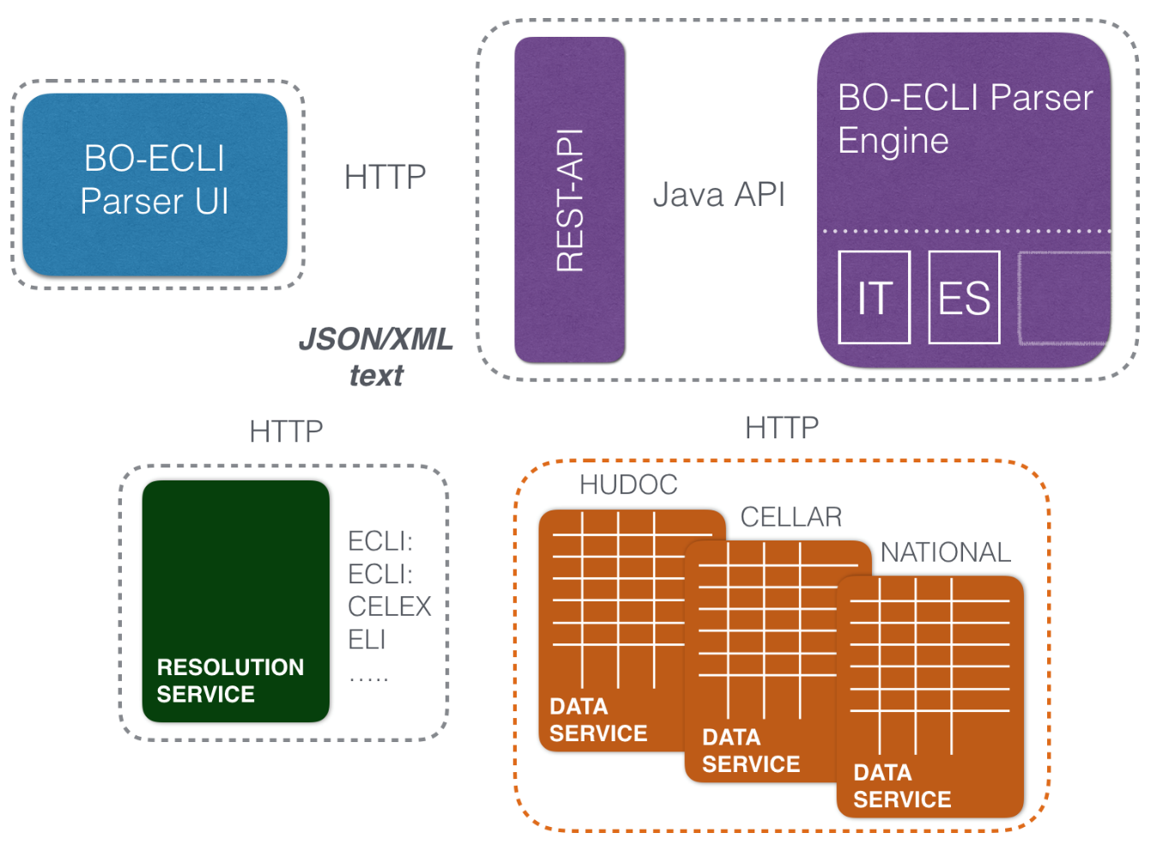
BO-ECLI PARSER
ECLI Conference
8th June 2017
Athens
Notes:
extensible and customizable automatic legal link extraction software
multilingual and multi jurisdiction scale
open-source software toolkit / services
Outcome: open-source software toolkit / services

Slide 5
BO-ECLI PARSER ENGINE
national citation practices analysis
Commonalities in national legal citation practices in the EU context:
A combination of citation attributes or features (DocType, Authority, Section, Date, Numbers, partitions, ..)
Alias: a common name for the destination document
Multiple citations
references to different documents of the same type or issued by the same authority
references to different partitions of the same document
Direct use of of identifiers in the text
ECLI Conference
8th June 2017
Athens
Notes:
common features and patterns in legal textual citations
A combination of citation attributes or features
Multiple citations:
references to different documents of the same type or issued by the same authority
references to different partitions of the same document
Alias: a common name for the destination document
Direct use of identifiers in the text

Slide 6
BO-ECLI Parser ENGINE
framework
Models a generic legal links extraction pipeline
Abstraction at language/jurisdiction independent level
(extendable) Common vocabularies for annotation
(e.g. document types – EU Authorities - EU Aliases, ..)
Common services (language/jurisdiction independent)
National specialization services (for national language/jurisdiction dependent tasks)
rule based text processing
regular expressions / lexical automata / pattern recognition
ECLI Conference
8th June 2017
Athens
Notes:
Recommended implementation in jFlex
Extraction pipeline modelled
Common services / national specialization services
Allow concrete national language/jurisdiction dependent implementations by means of rule based / regular expressions / lexical automata / pattern recognition
Common features (commonalities in legal citation practices, common patterns, common problems)
put in common language independent services
modelling of a generic legal citation detection pipeline
shared domain knowledge (e.g. extensible vocabularies for annotation, normalized values, EU aliases
services / patterns valid for different languages / jurisdictions

Slide 7
BO-ECLI Parser ENGINE
A pipeline of services
Entity identification services
Identify reference features and annotate with normalized values
Pattern recognition services
citation patterns recognition / optional custom features /structured reference representation
Identifier generation services
Computable identifiers / requiring access to external data
Rendering services
Default HTML – customizable rendering
ECLI Conference
8th June 2017
Athens
Notes:
ON SW Architecture : Extensibility
Services based Architecture
each service is responsible of a specific implementation
example of services
Common annotation format - Linguistic / Jurisdction independent abstraction (as an object model ?) and normalization
a pipeline of services of different kind (annotation / recognition / generation)
ANNOTATON
annotation phase [language dependent - encode authorities, document types, case numbering, decision numbering, legislation numbering, partition numbering, legislative aliases, your textual feature typically part of a legal citation]
RECOGNITION
recognition phase [your pattern / common pattern] separated by (your) empty words (? how are managed stopwords in pattern annotations ? )
THERE ARE common patterns / specific patterns / odd situations in any case
current json format / API : interact wth the textual annotation
GENERATION (explain with examples)
ECLI generation
generation phase sometimes the identifier can be generated based on the structured normalized features of a reference (algorthmic composition) - sometimes not

Slide 8
THE EXTRACTION PROCESS
Input text (IT): [..] la Corte Costituzionale con la sentenza n. 346 del 1995 ha dichiarato [..]
"legal-reference":
"text": "Corte Costituzionale con la sentenza n. 346 del 1995”,
"authority": "IT_COST",
"type": "JUDGMENT",
"doc-year": "1995",
"full-number": "346/1995",
"number": "346",
"is-case-law-reference": true,
"is-legal-reference": false,
"legal-identifier":
{
"type": "ECLI",
"code": "ECLI:IT:COST:1995:346",
"url": "https://e-justice.europa.eu/ecli/ECLI:IT:COST:1995:346",
"provenance": “"ECLI Generation Service for the Italian..
"confidence": 0.9
}
ECLI Conference
8th June 2017
Athens
Notes:
Textual citations
Structured reference: instantiated with (normalized values of) features recognized in the text (abstracted to language independent)
(possibly) equipped with Identifier (ECLI/ELI/CELEX/National id) - computed (id computable given – a set of – normalized features used in the citation) or retrieved (feature based identifier retrieval from reference repository exposed on the web – data services)

Slide 9
DEMO http://parser.bo-ecli.eu
que recoge el art. 191.2 del Tratado de Funcionamiento de la Union Europea y determino la Directiva 2004/35/CE, de 21 de abril, sobre responsabilidad
la L. 24 ottobre 2006, n. 269, art. 1, comma 3, lett. q), ed il D.Lgs. n. 109 del 2006, art. 15, comma 2, sono illegittimi in relazione agli artt. 3, 11, 24, 33, quinto comma, 35, 41, 102, 108, 111 e 117, primo comma, Cost.
"Corte Eur. Dir. Uomo, sez. 5, 12 marzo 2009, in causa n. 39874/05, Voskoboynyk c/ Ucraina”, ed anche Corte eur. dir. uomo, V sez., A.M. e aa. c/ Francia, ric. n. 24587/12
(in tal senso la sentenza Corte di giustizia, 12 giugno 2003, causa C-112/00, Schmidberger, punto 80).
(vedi Cass., Sez. 3^: 21.5.1993, n. 5230, P.C. in proc. Tessarolo e 13.11.1992, n. 10956, P.M. in proc. Serlenga ed altri).
La Seccion Quinta de esta Audiencia en Sentencia dictada el 22 de diciembre de 2014, (ROJ: SAP IB 2267/2014 - ECLI:ES:APIB:2014:2267), Sentencia: 338/2014 | Recurso: 476/2014 resolvio en el mismo sentido.
Infraccion de los arts. 82 y 85 del Real Decreto Legislativo 1/2007, de 16 de noviembre por el que se aprueba el texto refundido de la Ley General para la Defensa de los Consumidores y Usuarios, y del art. 5.5 del Real Decreto 515/1989 de 21 de abril, sobre proteccion […] en base a los arts. 1114 y 1123 del Codigo Civil , se produce […] previsto en el art. 240 y 901 de la LECRIM
Full text ECLI:IT:COST:2016:250
ECLI Conference
8th June 2017
Athens
Notes:
1) TFUE + DIR
que recoge el art. 191.2 del Tratado de Funcionamiento de la Union Europea y determino la Directiva 2004/35/CE, de 21 de abril, sobre responsabilidad
2) LEGGE CON PARTIZIONE FINO ALLA LETTERA, DECRETO LEGISLATIVO E ALIAS NAZIONALE
la L. 24 ottobre 2006, n. 269, art. 1, comma 3, lett. q), ed il D.Lgs. n. 109 del 2006, art. 15, comma 2, sono illegittimi in relazione agli artt. 3, 11, 24, 33, quinto comma, 35, 41, 102, 108, 111 e 117, primo comma, Cost.
3) ECHR con ECLI e senza
"Corte Eur. Dir. Uomo, sez. 5, 12 marzo 2009, in causa n. 39874/05, Voskoboynyk c/ Ucraina”, ed anche Corte eur. dir. uomo, V sez., A.M. e aa. c/ Francia, ric. n. 24587/12
4) CJEU, CASE NUMBER E APPLICANT (no ECLI)
(in tal senso la sentenza Corte di giustizia, 12 giugno 2003, causa C-112/00, Schmidberger, punto 80).
5) CASS - Multiplo - APPLICANT
(vedi Cass., Sez. 3^: 21.5.1993, n. 5230, P.C. in proc. Tessarolo e 13.11.1992, n. 10956, P.M. in proc. Serlenga ed altri).
6) La Seccion Quinta de esta Audiencia en Sentencia dictada el 22 de diciembre de 2014, (ROJ: SAP IB 2267/2014 - ECLI:ES:APIB:2014:2267), Sentencia: 338/2014 | Recurso: 476/2014 resolvio en el mismo sentido.
7) REAL DECRETO LEGISLATIVO E REAL DECRETO
Infraccion de los arts. 82 y 85 del Real Decreto Legislativo 1/2007, de 16 de noviembre por el que se aprueba el texto refundido de la Ley General para la Defensa de los Consumidores y Usuarios, y del art. 5.5 del Real Decreto 515/1989 de 21 de abril, sobre proteccion […] en base a los arts. 1114 y 1123 del Codigo Civil , se produce […] previsto en el art. 240 y 901 de la LECRIM
8) ECLI:IT:COST:2016:250

Slide 10
EXTRACTION PROCESS and results
Multilang ex2 – IT / ES
Input text: [..] art. 45, del Trattato sul Funzionamento dell’Unione Europea; da un altro [..]
"legal-reference": [
{
"text": "art. 45, del Trattato sul Funzionamento dell’
Unione Europea",
"partition": "article-45;",
"alias": "TREATY_FUNCTIONING_EU",
"is-case-law-reference": false,
"is-legal-reference": true,
ECLI Conference
8th June 2017
Athens
Notes:
que recoge el art. 191.2 del Tratado de Funcionamiento de la Union Europea y determino la Directiva 2004/35/CE, de 21 de abril, sobre responsabilidad
artt. 26, 45, 46, 49, 50, 56 e 57 del Trattato sul Funzionamento dell’Unione Europea; da un altro canto, comporta che i
y determino la Directiva 2004/35/CE, de 21 de abril, sobre responsabilidad
Peraltro, neppure la direttiva del Parlamento europeo e del Consiglio, dell’11 dicembre 2007, n. 2007/66/CE, la cui attuazione

Slide 11
EXTRACTION PROCESS and results
Multilang ex 2 – IT /ES
"legal-identifier": [
{
"type": "CELEX",
"code": "12008E045",
"url": "http://eur-lex.europa.eu/legal-content/IT/TXT/
?uri=CELEX:12008E045",
"provenance": "BOECLI DefaultLegislationAliasGeneration",
"confidence": 0.7
}
]
ECLI Conference
8th June 2017
Athens
Notes:
que recoge el art. 191.2 del Tratado de Funcionamiento de la Union Europea y determino la Directiva 2004/35/CE, de 21 de abril, sobre responsabilidad
artt. 26, 45, 46, 49, 50, 56 e 57 del Trattato sul Funzionamento dell’Unione Europea; da un altro canto, comporta che i
y determino la Directiva 2004/35/CE, de 21 de abril, sobre responsabilidad
Peraltro, neppure la direttiva del Parlamento europeo e del Consiglio, dell’11 dicembre 2007, n. 2007/66/CE, la cui attuazione

Slide 12
EXTRACTION PROCESS and results
Multilang ex2 – IT / ES
Input text: [..] que recoge el art. 191.2 del Tratado de Funcionamiento de la Union Europea y determino [..]
"legal-reference": [
{
"text": "art. 191.2 del Tratado de Funcionamiento de la
Union Europea",
"partition": "article-191;paragraph-2;",
"alias": "TREATY_FUNCTIONING_EU",
"is-case-law-reference": false,
"is-legal-reference": true,
ECLI Conference
8th June 2017
Athens
Notes:
que recoge el art. 191.2 del Tratado de Funcionamiento de la Union Europea y determino la Directiva 2004/35/CE, de 21 de abril, sobre responsabilidad
artt. 26, 45, 46, 49, 50, 56 e 57 del Trattato sul Funzionamento dell’Unione Europea; da un altro canto, comporta che i
y determino la Directiva 2004/35/CE, de 21 de abril, sobre responsabilidad
Peraltro, neppure la direttiva del Parlamento europeo e del Consiglio, dell’11 dicembre 2007, n. 2007/66/CE, la cui attuazione

Slide 13
EXTRACTION PROCESS and results
Multilang ex 2 – IT /ES
"legal-identifier":
"type": "CELEX",
"code": "12008E191",
"url": "http://eur-lex.europa.eu/legal-content/ES/TXT/
?uri=CELEX:12008E191",
"provenance": "BOECLI DefaultLegislationAliasGeneration",
"confidence": 0.7
ECLI Conference
8th June 2017
Athens
Notes:
que recoge el art. 191.2 del Tratado de Funcionamiento de la Union Europea y determino la Directiva 2004/35/CE, de 21 de abril, sobre responsabilidad
artt. 26, 45, 46, 49, 50, 56 e 57 del Trattato sul Funzionamento dell’Unione Europea; da un altro canto, comporta che i
y determino la Directiva 2004/35/CE, de 21 de abril, sobre responsabilidad
Peraltro, neppure la direttiva del Parlamento europeo e del Consiglio, dell’11 dicembre 2007, n. 2007/66/CE, la cui attuazione

Slide 14
WHAT DELIVERED
Open source software toolkit
Gitlab software projects / documentation
Source code / Java libraries (engine.jar, it.jar, es.jar)
deployed demo services: Legal links extraction Rest API / UI for user-interaction
OUTPUTS: Structured reference metadata (JSON / XML) / Annotated text / ECLI references metadata
ECLI Conference
8th June 2017
Athens
Notes:
Feel free to manage – design – arrange your content in one, two or more columns at the above two rectangular areas!

Slide 15
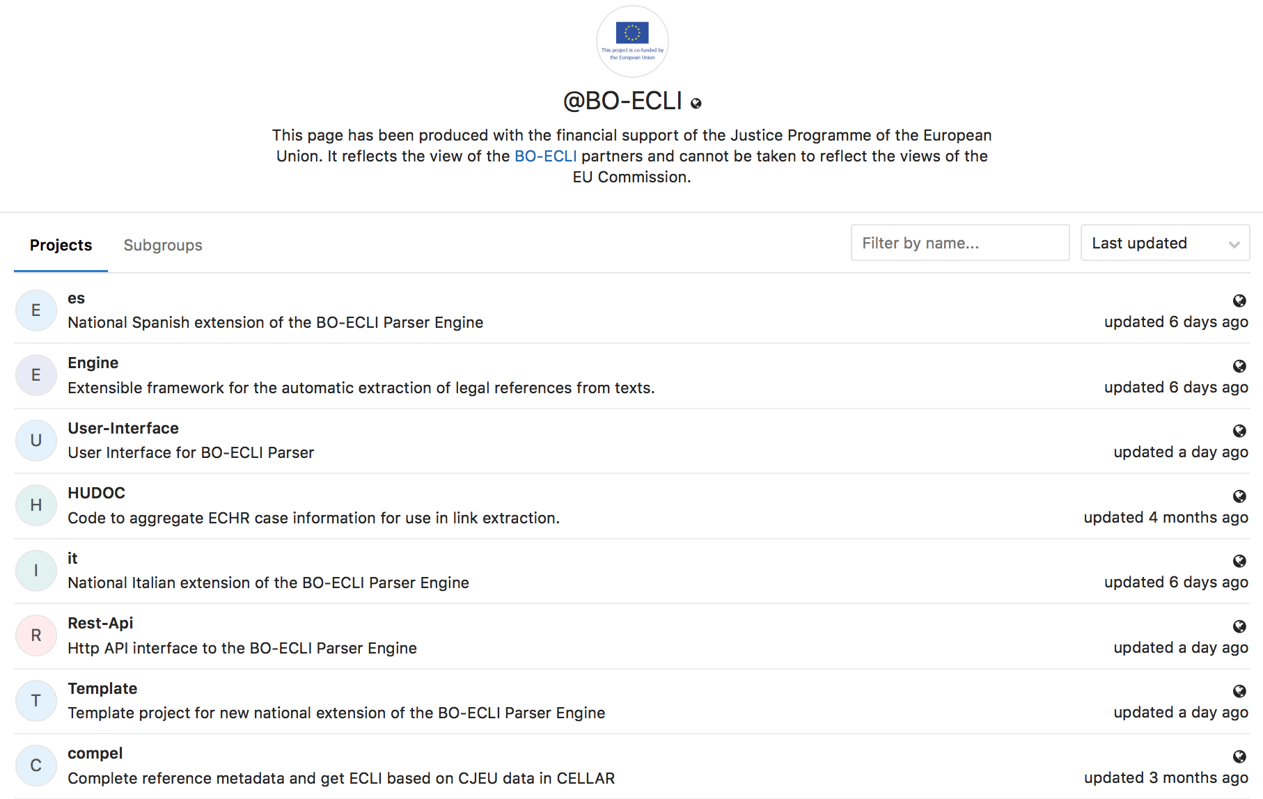
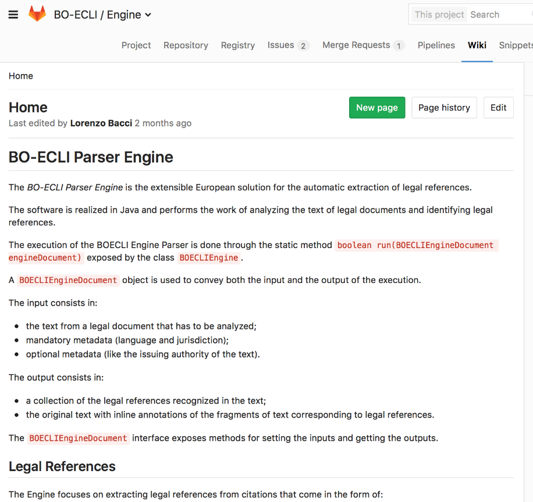
http://gitlab.com/BO-ECLI
ECLI Conference
8th June 2017
Athens
Notes:
Feel free to manage – design – arrange your content in one, two or more columns at the above two rectangular areas!

Slide 16
ADVANTAGES
For new implementers
Division of the reference extraction process into steps
Leverage on implemented solutions for typical recurrent problems in link extraction from legal texts
Common services with default implementations (especially for EU legal sources)
Shared Resources
Common vocabularies for annotation (especially for European authorities / document types / aliases)
Extendable
Flexibility in the customization (allow to tackle complex national specificities)
ECLI Conference
8th June 2017
Athens
Notes:
To whom is it oriented to
- legal expert + implementer (sw developer / rule writer)
- lowered entry barrier because the structure and architecture of the services is made available ; because most services are common and only the very specific language and legal aspects (where the real legal knowlwedge lies - national citation practice) is encoded and replaced by a single (proposed) identifier
#proposed 1 or more than one identifier with a confidence that can be set: to be taken as they are or validated
specific rules: custom features / common citation practices national rules

Slide 17
ADVANTAGES
Common services implementation
ECLI identification
Partitions identification
Parties identification
Reference recognition
ECLI generation for EU case-law
ELI/CELEX generation for EU legislation
CELEX generation for European aliases
HTML Rendering
ECLI Conference
8th June 2017
Athens

Slide 18
FURTHER DEVELOPMENTS
Extend national coverage
Evaluation of national implementations
Further development of external distributed services and interfacement
Standardization of the exchange format RDF/JSON-LD → WS-3
ECLI Conference
8th June 2017
Athens
12
Notes:
Feel free to manage – design – arrange your content in one, two or more columns at the above two rectangular areas!

Slide 19
Thank you for your attention!
BO-ECLI PARSER
http://parser.bo-ecli.eu
This presentation has been produced with the financial support of the Justice Programme of the European Union. The contents of this publication are the sole responsibility of the partners of the BO-ECLI project and can in no way be taken to reflect the views of the European Commission.
This project is co-funded by
the European Union

